Slide 1

Enhancing TextBlob Sentiment Analysis for Amazon App Reviews Comparative Analysis with VADER Sentiment Analysis Tool
Xian Cao & ShuRui Liu

Slide 2
Introduction
A study on the sentiment analysis of COVID-19 tweets from selected hashtags in Nigeria using VADER and TextBlob revealed differences in sentiment classification, with VADER detecting 39.8% positive, 31.3% neutral, and 28.9% negative sentiments, whereas TextBlob identified 46.0% neutral, 36.7% positive, and 17.3% negative sentiments (Abiola, Abayomi-Alli, Tale, Misra, & Abayomi-Alli, 2023).

Slide 3
Significance
Customer reviews play a critical role in app development, as they provide valuable insights into user needs and experiences. Sentiment analysis, therefore, offers significant advantages by extracting and interpreting these insights from user feedback.
However, the reliability of using TextBlob for conducting app review sentiment analysis remains uncertain.

Slide 4
Research Aim
This research aims to compare the predicted sentiment with the ground truth sentiment to uncover the weaknesses of TextBlob.
Improve sentiment analysis accuracy for Amazon app reviews.
Enhance TextBlob's sentiment lexicon with domain-specific words.
Compare the performance of the enhanced TextBlob with the original TextBlob and VADER.

Slide 5
Data collection
Project. Amazon Shopping Reviews || EDA & Modeling
https://www.kaggle.com/code/lko9911/project-amazon-shopping-reviews-eda-modeling

Slide 6
Methodology - Data Preparation
Dataset: Amazon app reviews
Steps:
Cleaning: Lowercasing, removing special characters and punctuation, eliminating extra whitespace.
Tokenization: Splitting text into individual words.
Stopword Removal: Removing common English stopwords, excluding negations.
Lemmatization: Reducing words to their base forms.

Slide 7
Methodology - Sentiment Analysis Approaches
Compute Polarity
Use TextBlob to calculate sentiment polarity (-1 to 1).
Categorize Sentiment
Assign sentiment categories based on polarity scores.
Visualize Data
Plot polarity distribution and sentiment counts.
Evaluate Performance
Compare predicted sentiment with ground truth labels.

Slide 8
Polarity and Sentiment
Understanding Polarity:
Polarity measures the sentiment expressed in a text.
Polarity scores range from -1 (very negative) to 1 (very positive), with 0 being neutral.
Understanding Sentiment:
Sentiment refers to the overall attitude or emotion conveyed in the text (positive, negative, neutral).

Slide 9
TextBlob's Pattern Library
Polarity and Subjectivity:
Each word in the lexicon has a polarity score (ranging from -1 to 1).
Words also have a subjectivity score (ranging from 0 to 1), indicating the degree of personal opinion versus factual information.

Slide 10
Polarity Calculation
TextBlob calculates the polarity of a text by averaging the polarity scores of individual words.
The formula takes into account the intensity and frequency of words in the text.

Slide 11
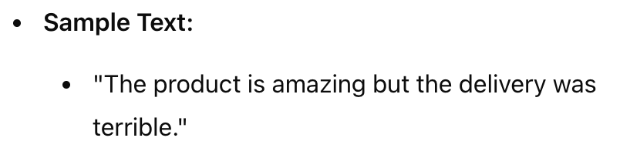
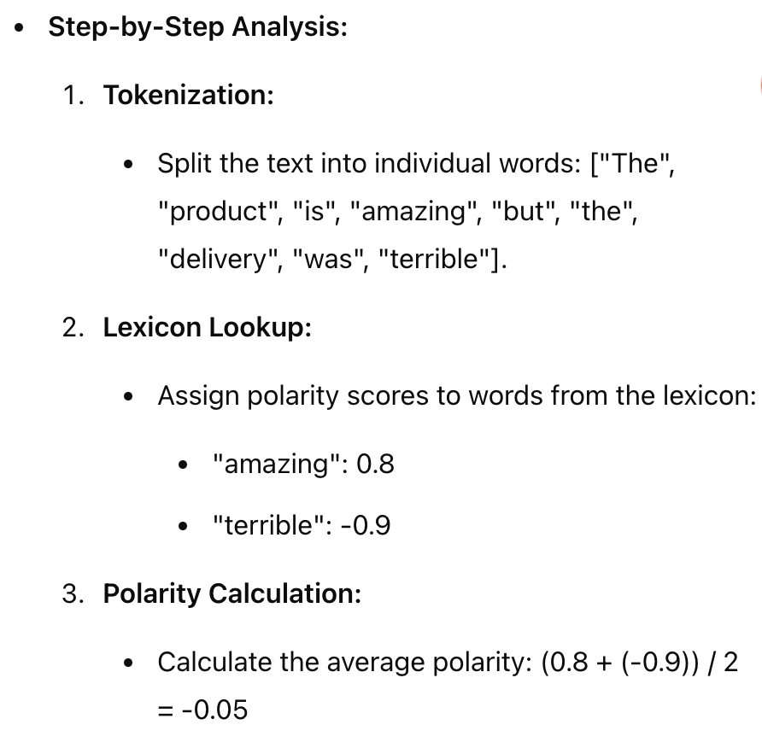
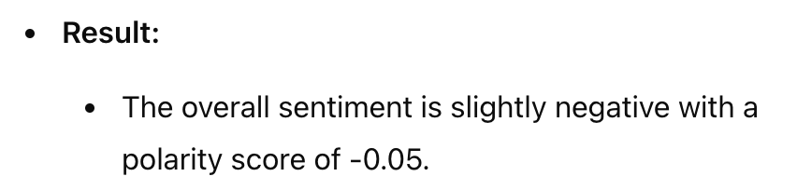
Example of TextBlob Sentiment Analysis

Slide 12
Methodology - Sentiment Analysis Approaches
1. Original TextBlob Sentiment Analysis [Base line]
2. VADER Sentiment Analysis [A similar sentiment analysis tool]
3. Enhanced TextBlob Sentiment Analysis [two stages]

Slide 13
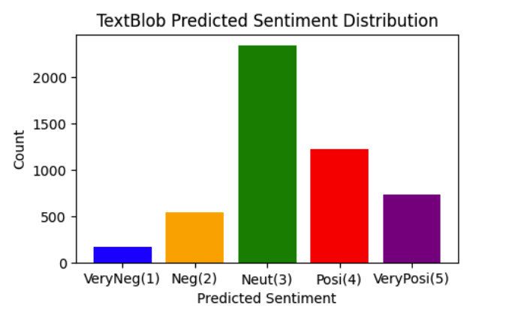
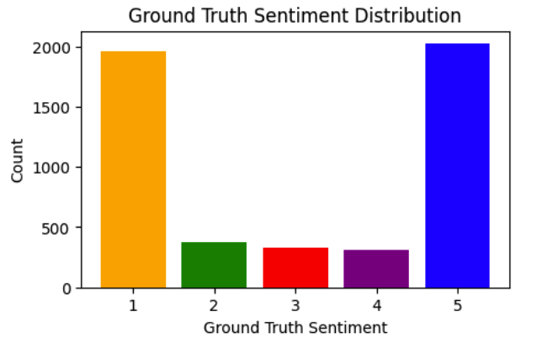
Result Analysis - TextBlob (Bad Performance)

Slide 14
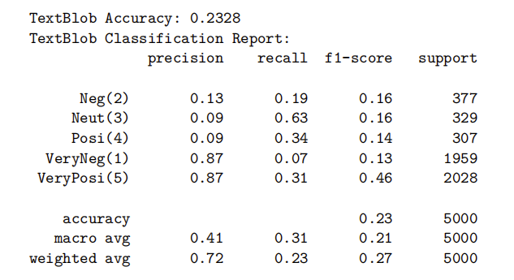
Result Analysis - TextBlob (How bad ? Accuracy and Classification Report)

Slide 15
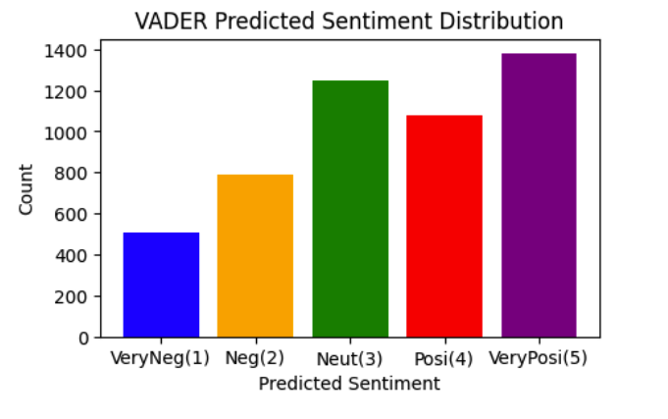
Result Analysis - VADER (Bad Performance)

Slide 16
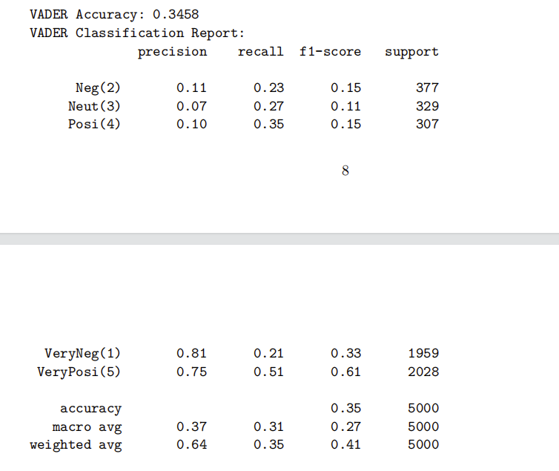
Result Analysis - VADER (How bad ? Accuracy and Classification Report)

Slide 17
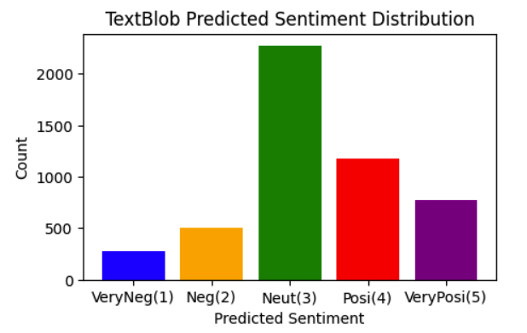
Result Analysis - TextBlob Stage1 (Enhanced Lexicon, Custom Analyzer)

Slide 18
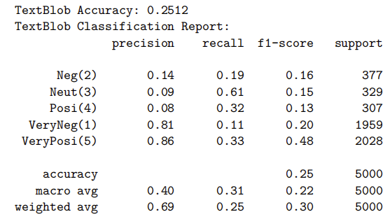
Result Analysis - TextBlob Stage1 (Better? Yes. But not significant at all. 0.2512 > 0.2328 Let’s keep working on modification)

Slide 19
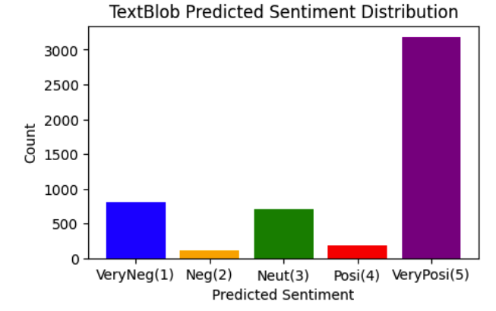
Result Analysis - TextBlob Stage2 (Enhanced Lexicon, Domain-specific words) The distribution are alike, which is very promising!

Slide 20
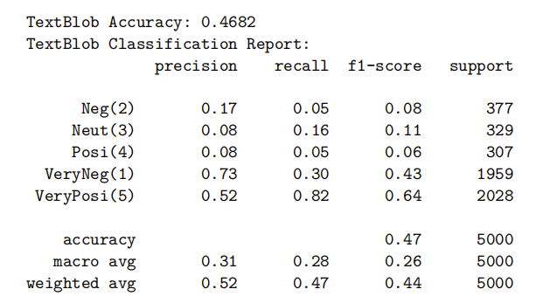
Result Analysis - TextBlob Stage 2 (Better? Yes! 0.4782 > 0.2512 > 0.2328. Even better than VADER, which has accuracy of 0.3458

Slide 21
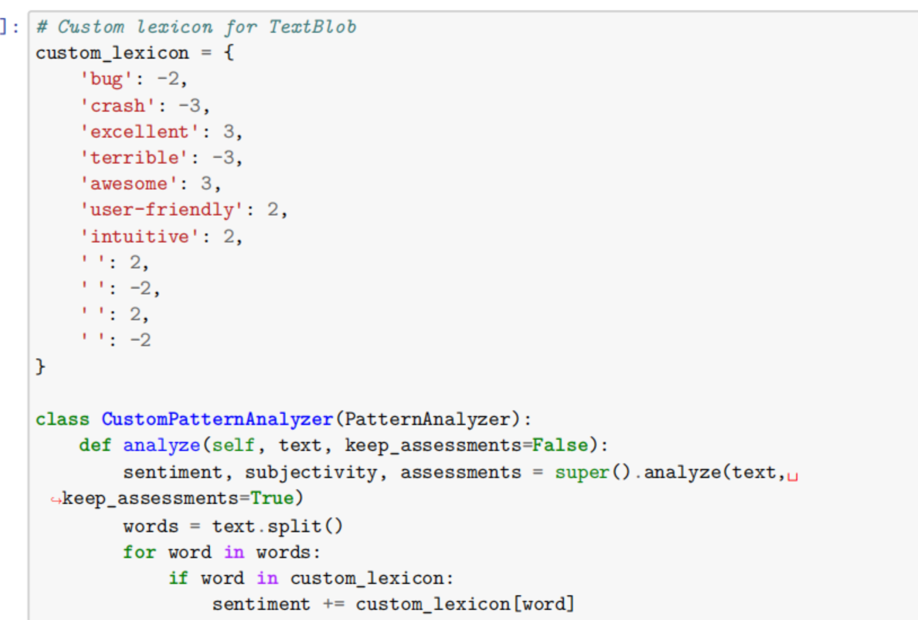
Modification: why improved ?
Stage1: custom analyzer

Slide 22
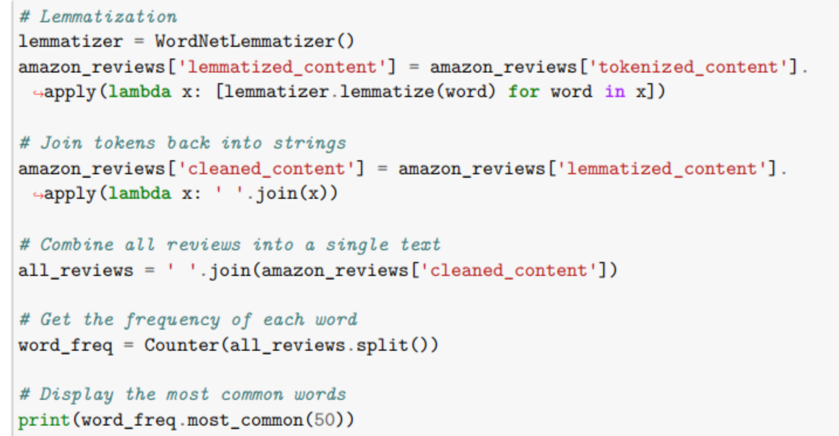
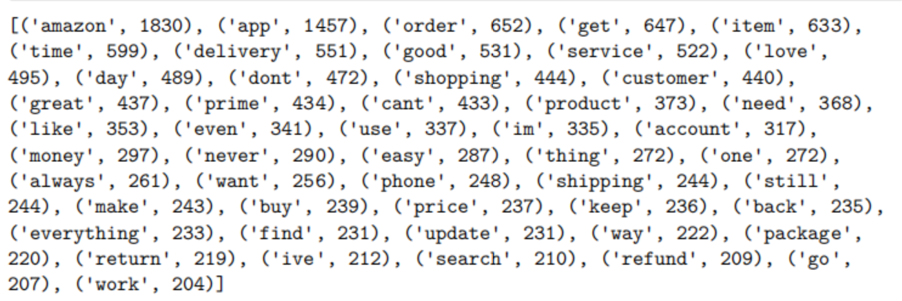
Modification: why improved ?
Stage2: Domain Words

Slide 23
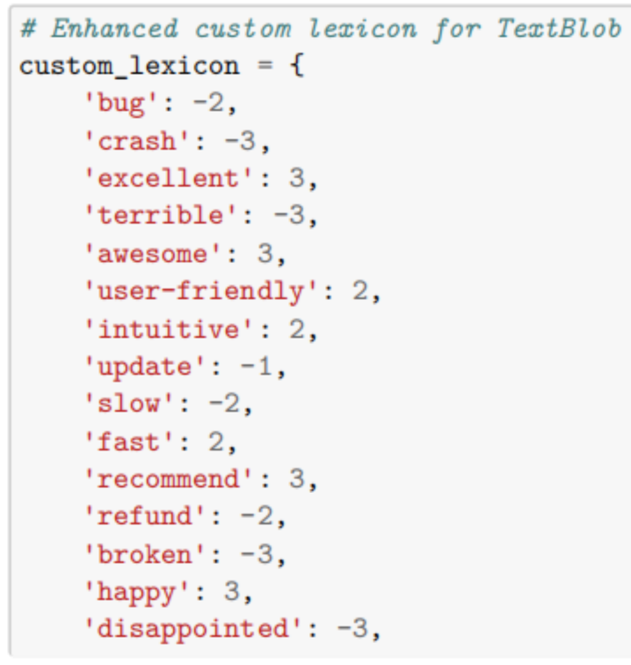
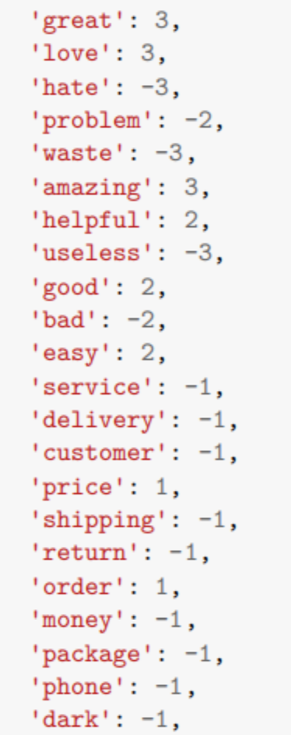
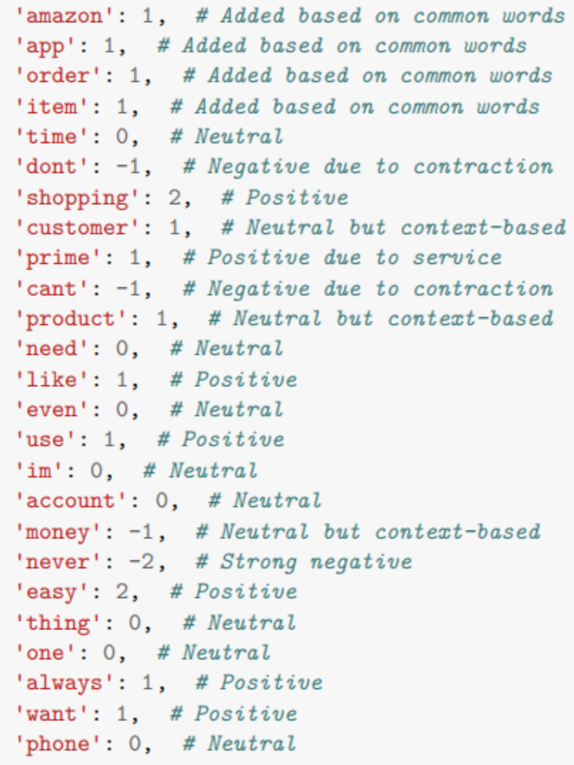
Modification: why improved ?
Stage2: Domain Words Enhanced Sentiment Lexicon

Slide 24
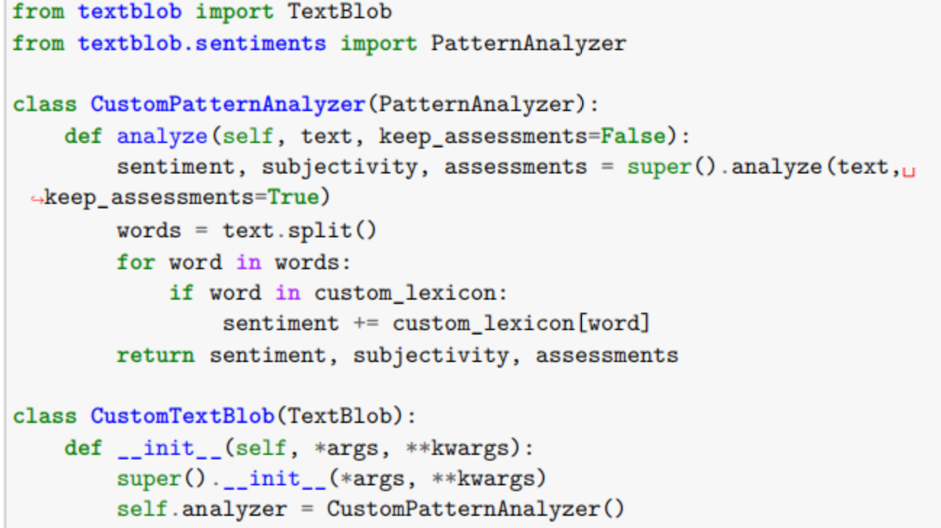
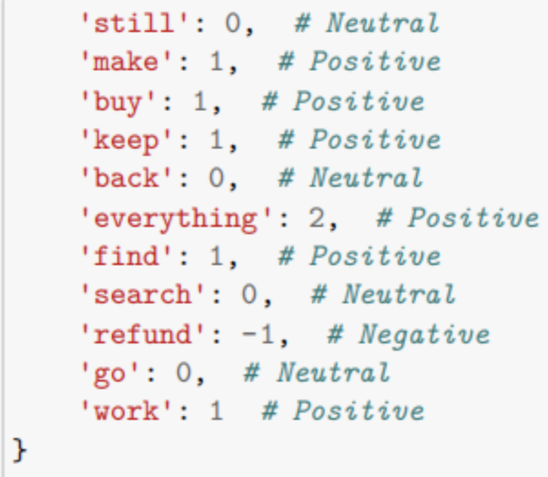
Modification: why improved ?
Stage2: Domain Words Enhanced Sentiment Lexicon

Slide 25
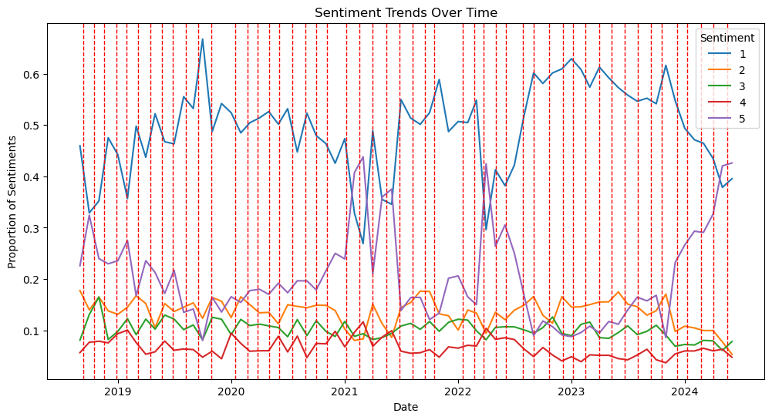
1. Continue refining high-frequency words and their polarities relevant to Amazon reviews 2. Take intensity into account 3. Introduce models that can detect sarcasm to further improve TextBlob's accuracy. 4.Sentiment Trends Over Time

Slide 26
Reference list
Abiola, O., Abayomi-Alli, A., Tale, O. A., Misra, S., & Abayomi-Alli, O. (2023). Sentiment analysis of COVID-19 tweets from selected hashtags in Nigeria using VADER and Text Blob analyser. Journal of Electrical Systems and Information Technology, 10(1), 5.

